Slide 1

Unit-3 Syllabus
Combinational logic and arithmetic circuit 6 6
Encoders and Decoders, Multiplexers and Demultiplexers, Adder, subtractors, comparators, introduction to Programmable Logic Devices (PLDs) like FPGA, Overview of IC classification.

Slide 2
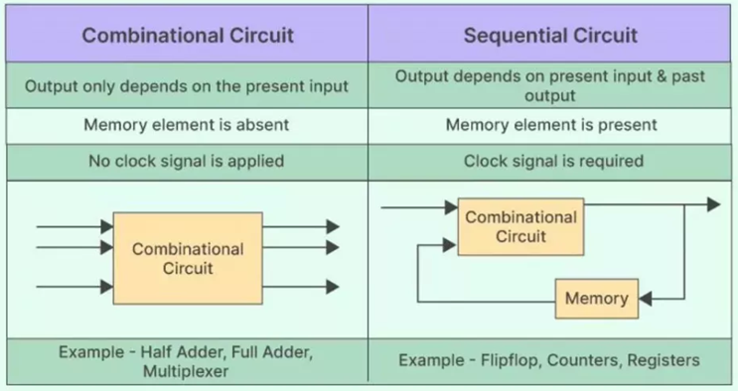
Classification of Digital Circuits
The digital systems in general are classified into two categories namely:
Combinational logic circuits
Sequential logic circuits.

Slide 3
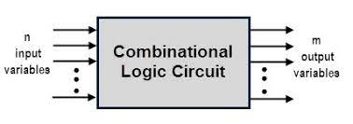
Combinational Circuits
Identify number of Input & Output .
Construct Truth Table.
Write Logical Expression in SOP and POS Form.
Minimize Logical Expression.
Implement Logic Circuits.

Slide 4
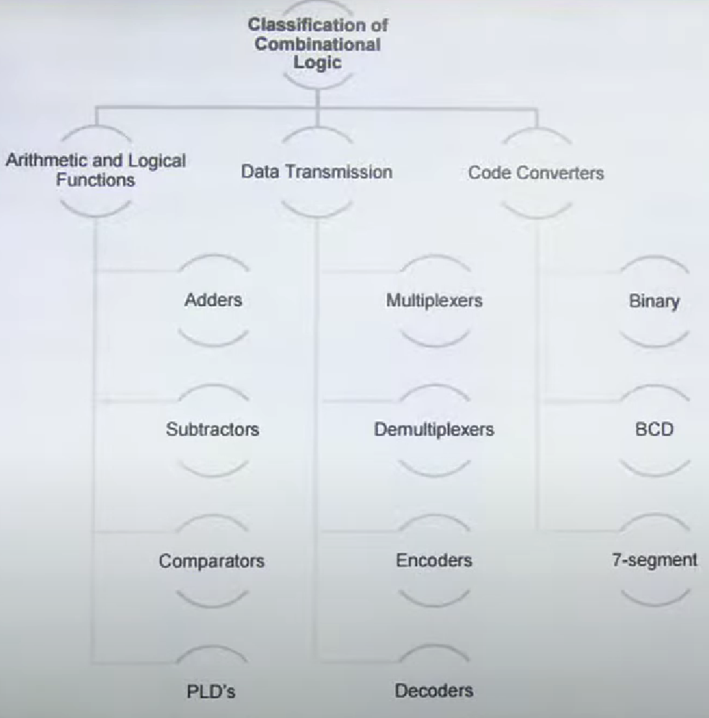
Examples of Combinational Circuits
Following are the examples of some combinational circuits:
Half Adder, Full Adder
Half Subtractor, Full Subtractor
Multiplexers, Demultiplexers
Encoders, Decoders
Comparator & Code Converters

Slide 5
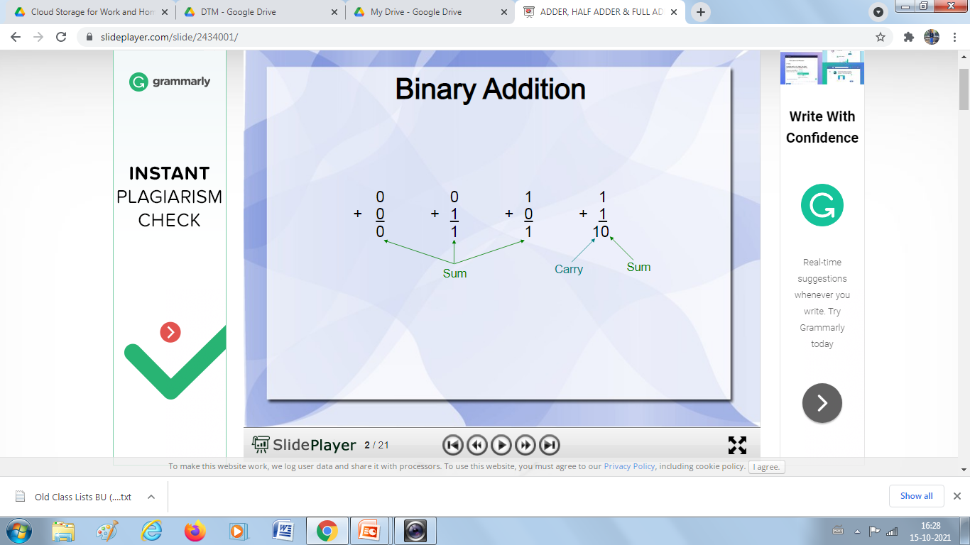
Adder
An Adder is a combinational circuit in digital electronics that performs binary addition.
It takes two or more binary numbers as input.
Produces the sum and sometimes a carry as output.
Adders are the basic building blocks in ALU (Arithmetic Logic Unit), processors, and calculators.
Types of Adders
Half Adder (HA)
Full Adder (FA)

Slide 6
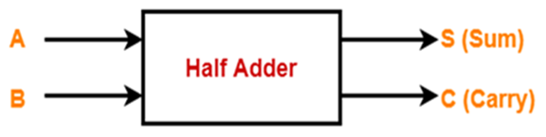
Half Adder (HA)
A Half Adder is the simplest combinational circuit in digital electronics that adds two single-bit binary numbers.
It has:
Inputs → 2 (A, B)
Outputs → 2 (Sum, Carry)

Slide 7

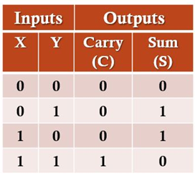
HA-Truth Table
Step-1: Identify the Input and Output Variables
Step-2: Draw the Truth Table

Slide 8
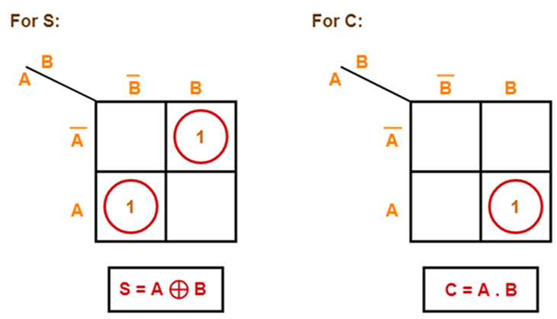
HA-K Maps
Step-3: Draw K-Map using Truth Table & determine the simplified Boolean Expression

Slide 9
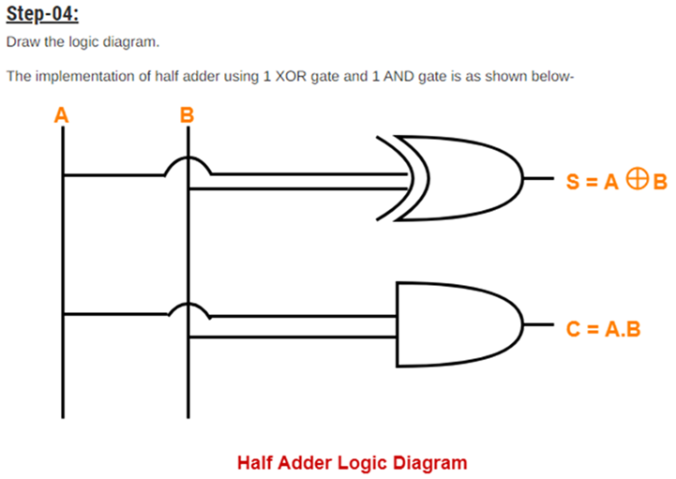
HA-Logic Diagram

Slide 10
HA-Limitations
Limitation of Half Adder
It cannot perform addition when there is an input carry from a previous stage.
That’s why we need a Full Adder for multi-bit addition.
✅ In short:
A Half Adder adds two binary inputs (A, B).
Outputs: Sum = A ⊕ B, Carry = A · B.
Built using XOR and AND gates.
Useful for simple 1-bit addition but cannot handle carry input.

Slide 11
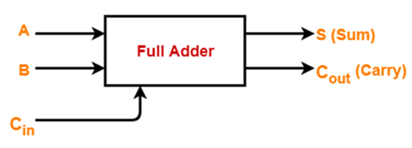
Full Adder (FA)
A Full Adder is a combinational logic circuit that performs the addition of three input bits:
A → First input
B → Second input
Cin → Carry input (from a previous addition stage)
It produces two outputs:
Sum (S)
Carry-out (Cout)
👉 Unlike the Half Adder, the Full Adder can handle carry input, making it suitable for multi-bit addition.

Slide 12

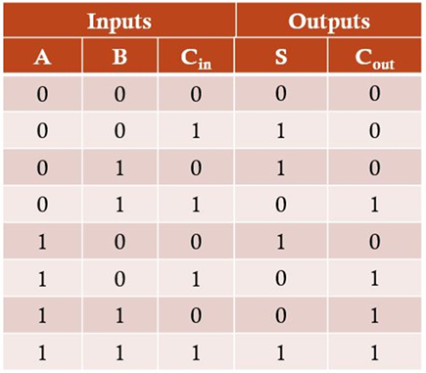
FA-Truth Table
Step-1: Identify the Input and Output Variables
Step-2: Draw the Truth Table

Slide 13
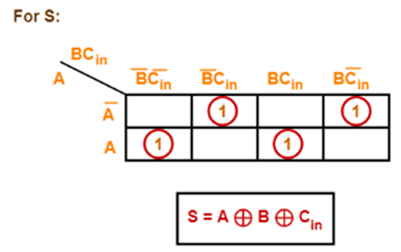
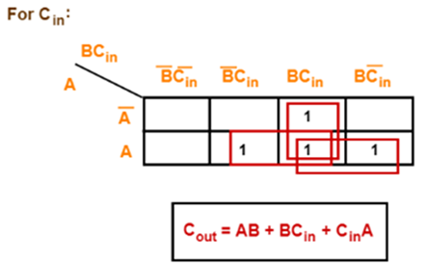
FA-K Map
Step-3: Draw K-Map using Truth Table & determine the simplified Boolean Expression

Slide 14
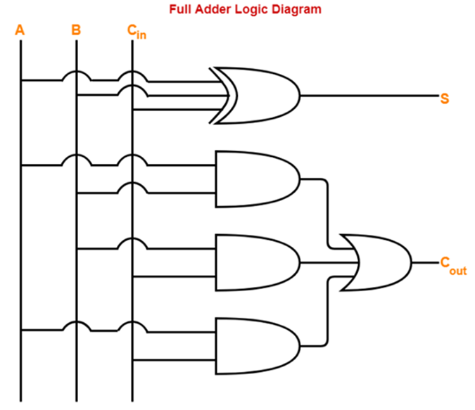
FA-Logic Diagram

Slide 15
Cont…
Advantages
Supports carry input.
Building block for multi-bit adders.
Widely used in ALUs, CPUs.
Can be built using simple Half Adders.
Limitations
Slower for large bit operations (carry delay).
More hardware complexity than Half Adder.
Limited to binary addition.

Slide 16
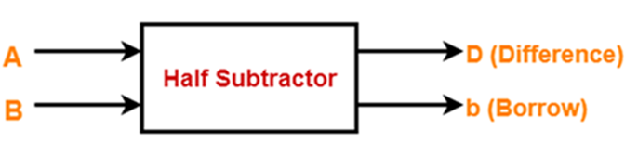
Half Subtractor (HS)
A Half Subtractor is a combinational logic circuit used to perform the subtraction of two binary digits. It has two inputs and two outputs:
Inputs → A (minuend) and B (subtrahend)
Outputs → Difference (D) and Borrow (B)
It is called "half" because it cannot handle borrow input from a previous stage.

Slide 17

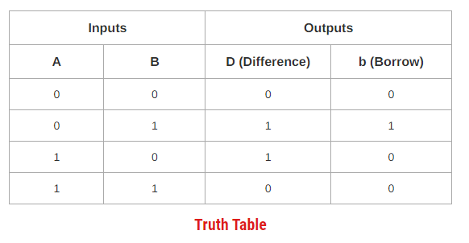
HS-Truth Table
Step-1: Identify the Input and Output Variables
Step-2: Draw the Truth Table

Slide 18
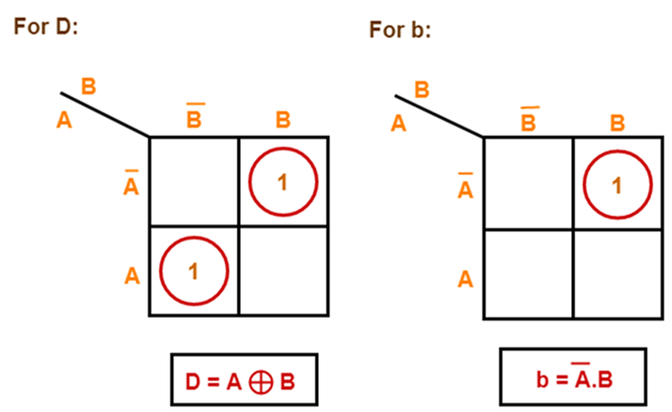
HS-K Map
Step-3: Draw K-Map using Truth Table & determine the simplified Boolean Expression

Slide 19
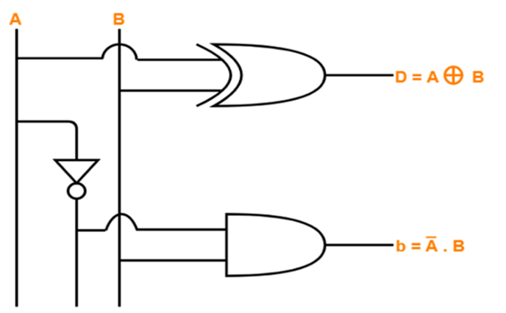
HS-Logic Diagram
Step-4: Draw the Logic Diagram

Slide 20
HA-Limitations
Half subtractors do not take into account "Borrow-in" from the previous circuit.
This is a major drawback of half subtractors.
This is because real time scenarios involve subtracting the multiple number of bits which can not be accomplished using half subtractors.

Slide 21
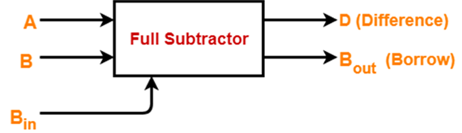
Half Subtractor (HS)
Full Subtractor is a combinational logic circuit.
It is used for the purpose of subtracting two single bit numbers.
It also takes into consideration borrow of the lower significant stage.
Thus, full subtractor has the ability to perform the subtraction of three bits.
Full subtractor contains 3 inputs and 2 outputs (Difference and Borrow) as shown below:

Slide 22

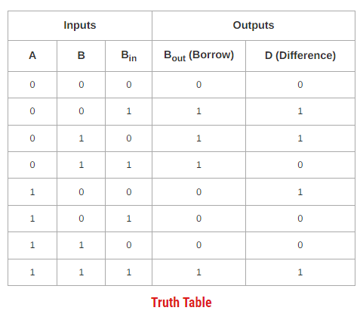
FS-Truth Table
Step-1: Identify the Input and Output Variables
Step-2: Draw the Truth Table

Slide 23
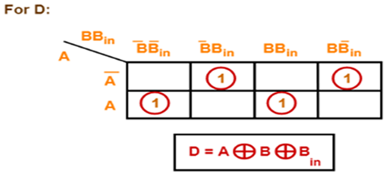
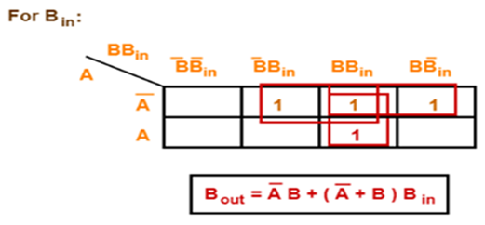
HS-K Map
Step-3: Draw K-Map using Truth Table & determine the simplified Boolean Expression

Slide 24
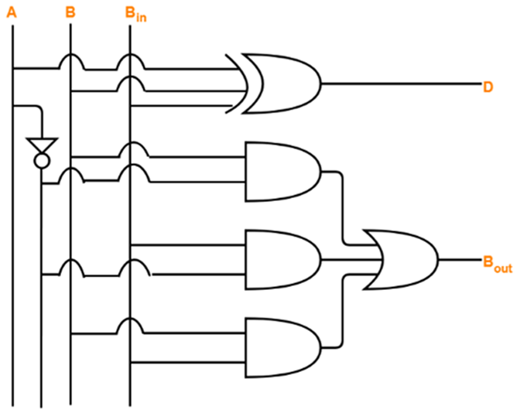
HS-Logic Diagram
Step-4: Draw the Logic Diagram

Slide 25
Cont…

Slide 26

MUX & DEMUX

Slide 27
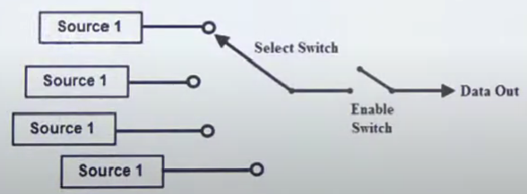
Multiplexer (Data Selectors)
What are multiplexers? Draw the logical circuits and describe its working.
The term Multiplexer means many into one.
A Digital Multiplexer (MUX) is a combinational Circuit with more than One Input Lines, One output lines and more than one select lines.
A Multiplexer is a Digital Switch, also called a Data Selector.
It allows the binary information from several input lines or sources and depending on the set of select lines, particular input line, is routed onto a single output line.

Slide 28
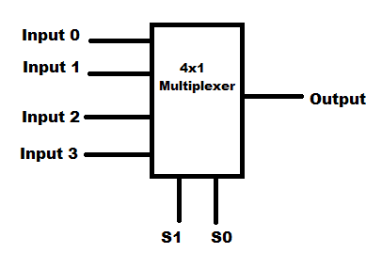
Cont…
MUX directs one of the inputs to its output line by using a control bit word (selection line) to its select lines.
Multiplexer contains the followings:
Data Inputs
Selection Inputs
A Single Output
Selection input determines the input that should be connected to the output.
The multiplexer acts like an electronic switch that selects one from different.

Slide 29
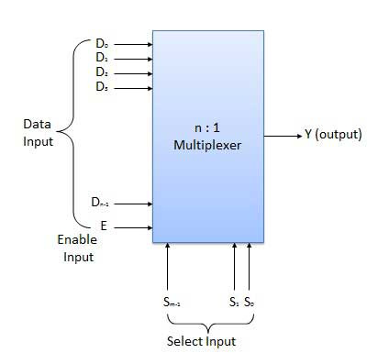
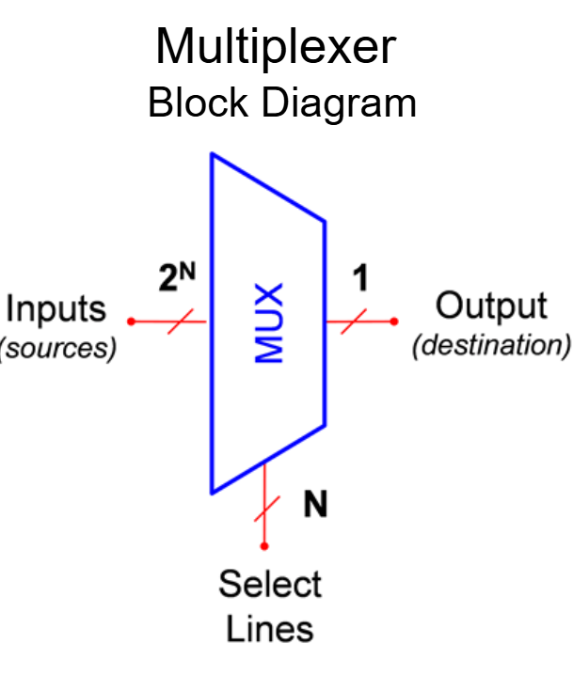
Cont…

Slide 30
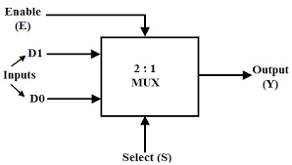
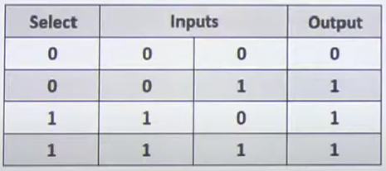
2:1Multiplexer
Draw the symbol and write truth table of 2:1 MUX
The block schematic of a 2 : 1 multiplexer is shown below:
It has two data inputs Do and D₁, one select input S, an enable input E and one output Y.
The truth table of this MUX is shown below:
D1
D0

Slide 31
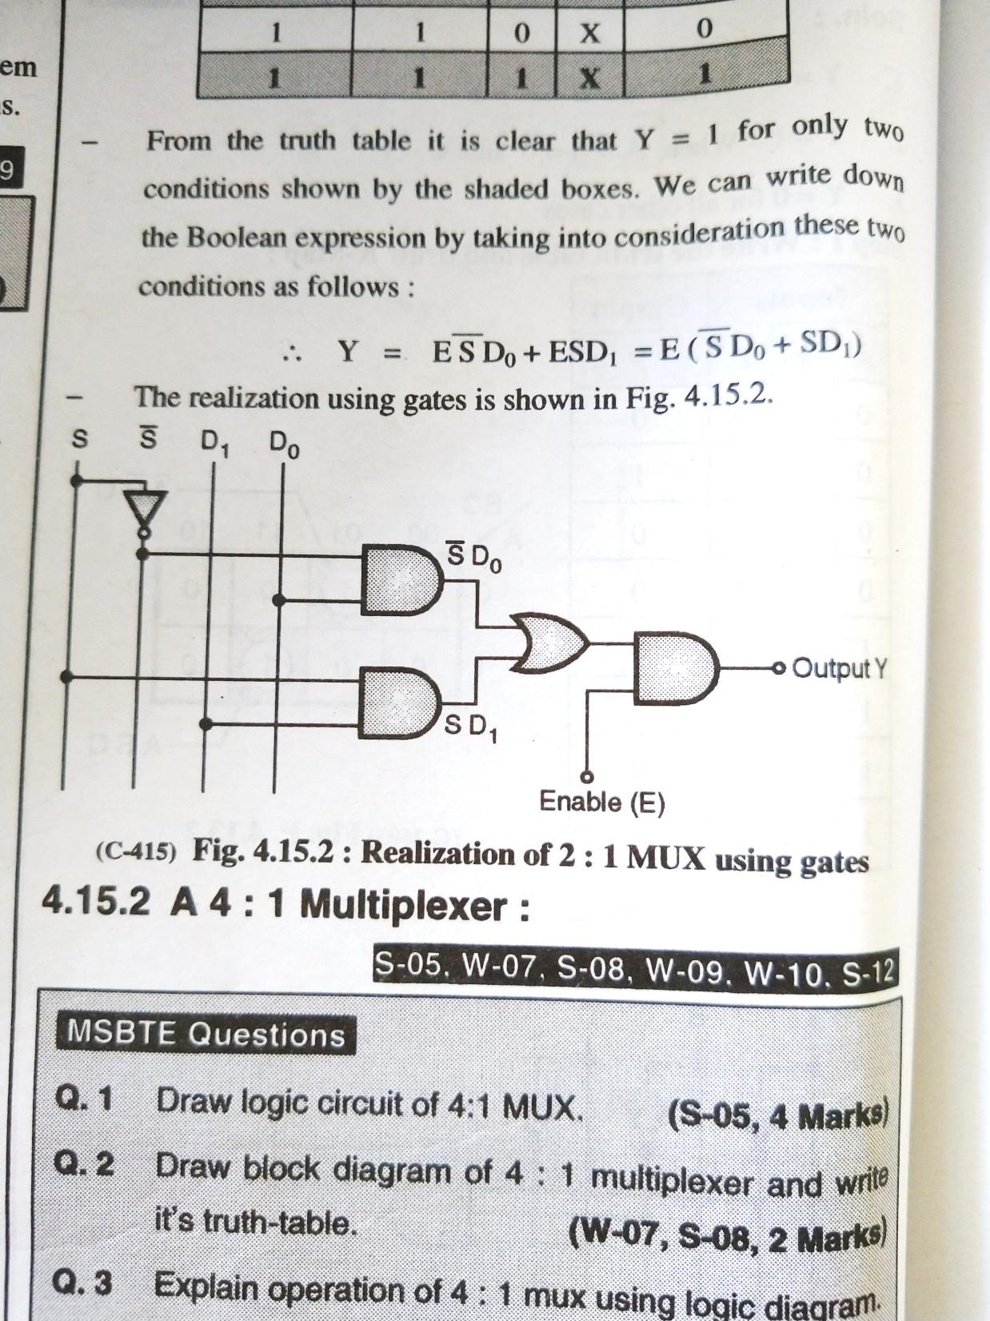
Cont…
When enable i/p is high then only works.
Enable | Select Input S | Output Y
0 | X | 0
1 | 0 | D0
1 | 1 | D1

Slide 32
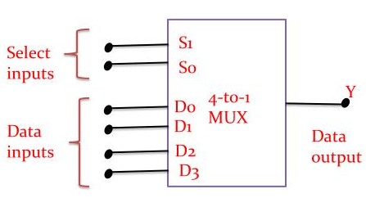
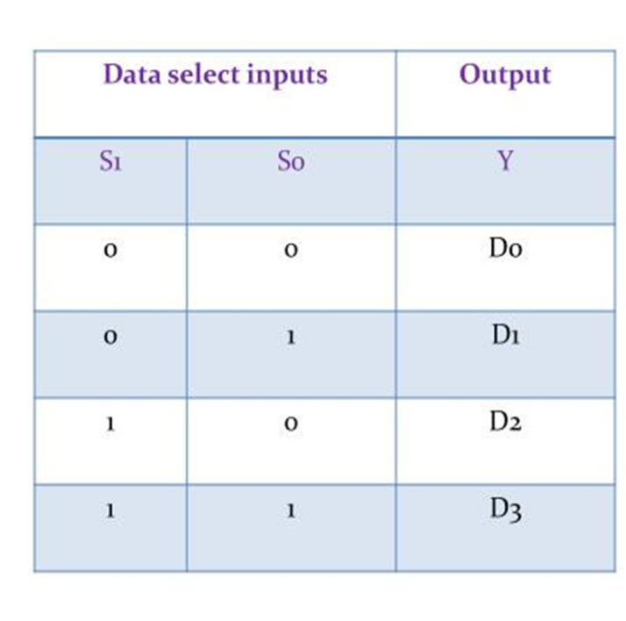
4:1Multiplexer
Fig. shows the block diagram of a 4: 1 multiplexer and Table gives its truth table.
Note that n = 4 hence number of select lines i.e. m = 2 so that 2 = n.
The truth table tells us that if S₁ So 00, the data bit Do is selected and routed to output Y = Do
Similarly if S₁ So 01, then D₁ is selected and routed to the output Y = D₁
Y = D₂ for S₁ So = 10 and Y = D3 for S₁ So 11

Slide 33
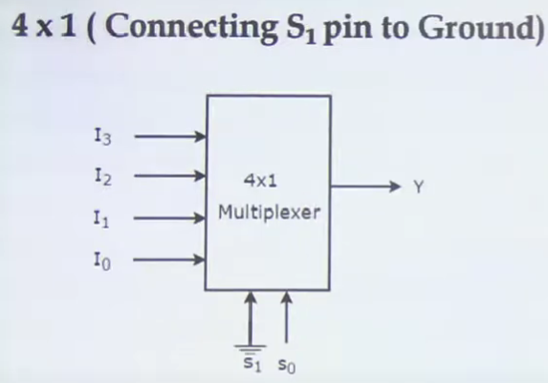
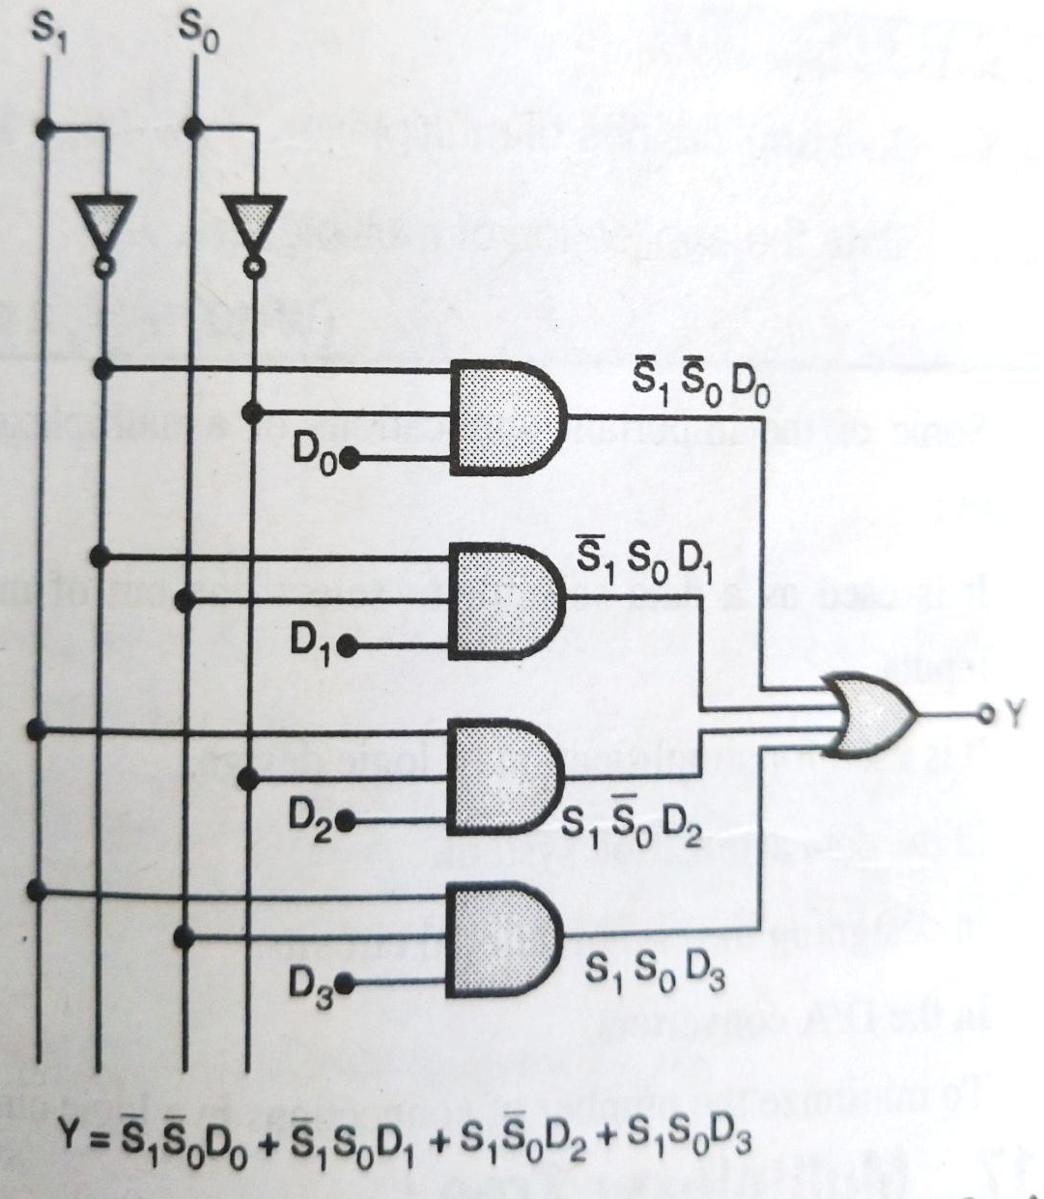
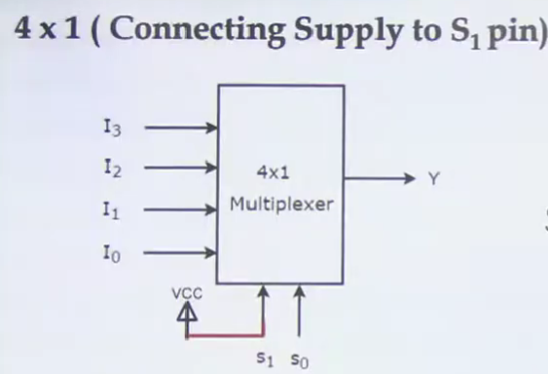
Cont…
This expression can be realized using basic gates as shown in

Slide 34
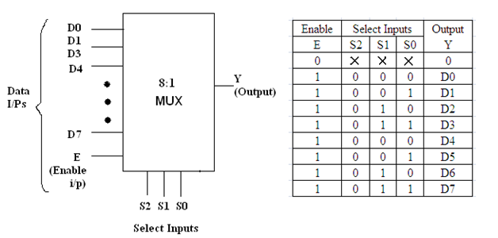
8:1Multiplexer

Slide 35
Cont…
The block diagram of an 8 1 MUX is shown in Fig. 1and its truth table is shown in Fig. 2. It has eight data inputs, one enable input, three select inputs and one output.
Operating principle :
When the strobe or enable input is 0, the multiplexer will be 0 irrespective of any input. With E = 1, we can select any one of the eight data inputs and of the connect it to the output.
For example if S₂ S, So = 0 1 1 then the data input D, is selected and output Y will follow the selected input D3.
Realization using gates :
The expression for output Y can be obtained from the truth table of Fig. as
The realization of 8 : 1 MUX using gates is shown in Fig.

Slide 36
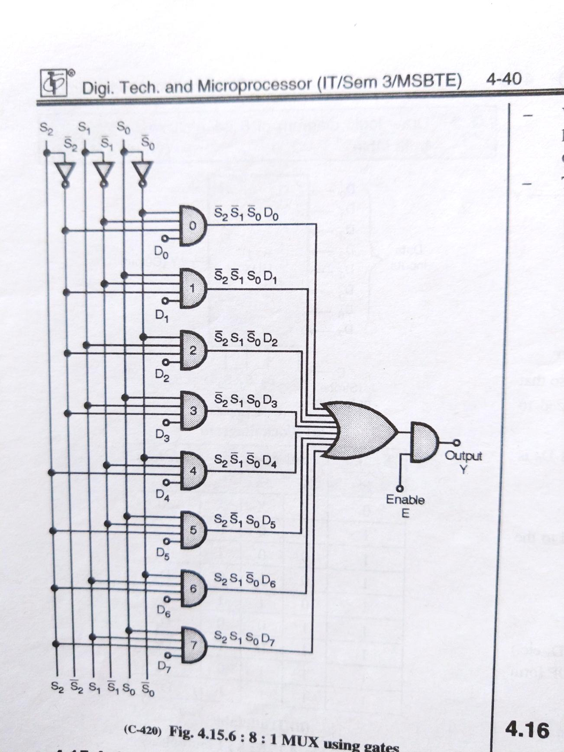
Cont…

Slide 37
8:1 Multiplexer using 4:1 Multiplexer
D₀
D₁
Y₁
D₂
4:1
Mux
D₃
D₀
E
S₀
2:1
Mux
Y
S₁
D₁
S₁
S₀
Output
E
S₁
S₀
D₄
D₅
S₂
4:1
Mux
D₆
Y₂
D₇
E

Slide 38
8:1 Multiplexer using 4:1 Multiplexer
D₀
D₁
Y₁
D₂
4:1
Mux
D₃
S₂
E
S₀
Select
Lines
S₁
Y
S₁
S₀
Output
S₁
S₀
D₄
D₅
4:1
Mux
D₆
Y₂
D₇
E

Slide 39
16:1 Multiplexer
D₀
D₁
D₂
D₃
D₄
D₅
Data
Inputs
D₆
Y
D₇
16:1
Mux
D₈
D₉
Output
D₁₀
D₁₁
D₁₂
D₁₃
D₁₄
D₁₅
Block Diagram
E
Enable Input
S₃
S₂
S₁
S₀
Select Lines

Slide 40
16:1 Multiplexer
Enable | Select Lines |  |  |  | Output
E | S₃ | S₂ | S₁ | S₀ | Y
0 | X | X | X | X | 0
1 | 0 | 0 | 0 | 0 | D₀
1 | 0 | 0 | 0 | 1 | D₁
1 | 0 | 0 | 1 | 0 | D₂
1 | 0 | 0 | 1 | 1 | D₃
1 | 0 | 1 | 0 | 0 | D₄
1 | 0 | 1 | 0 | 1 | D₅
1 | 0 | 1 | 1 | 0 | D₆
1 | 0 | 1 | 1 | 1 | D₇
1 | 1 | 0 | 0 | 0 | D₈
1 | 1 | 0 | 0 | 1 | D₉
1 | 1 | 0 | 1 | 0 | D₁₀
1 | 1 | 0 | 1 | 1 | D₁₁
1 | 1 | 1 | 0 | 0 | D₁₂
1 | 1 | 1 | 0 | 1 | D₁₃
1 | 1 | 1 | 1 | 0 | D₁₄
1 | 1 | 1 | 1 | 1 | D₁₅
Truth Table

Slide 41
Applications of a Multiplexer
Some of the important applications of a multiplexer are as follows:
It is used as a data selector to select one out of many data inputs.
It is used for simplification of logic design.
In the data acquisition system. In designing the combinational circuits.
In the D/A converters.
To minimize the number of connections in a logic circuit.

Slide 42
De-Multiplexer
The De-Multiplexer is a combinational logic circuit that performs the reverse operation of multiplexer (Several output lines, one input line).
De -Multiplexer means one to many.
A De-Multiplexer is a circuit with one input and many output. By applying control signal, we can steer any input to the output. Few types of De -Multiplexer are 1-to 2, 1-to-4, 1-to-8 and 1-to 16 De -Multiplexer .
De-Multiplexer is the process of taking information from one input and transmitting the same over one of several outputs.

Slide 43
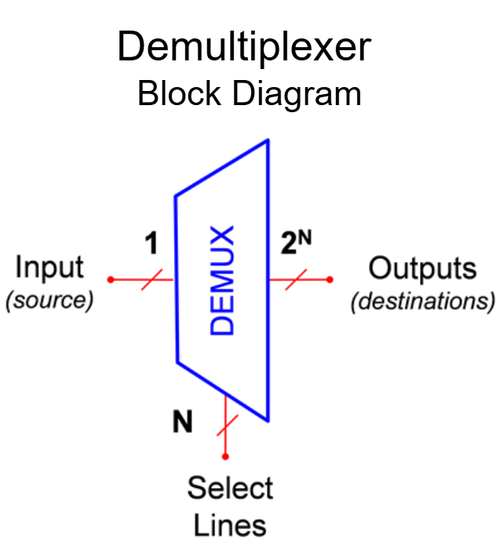
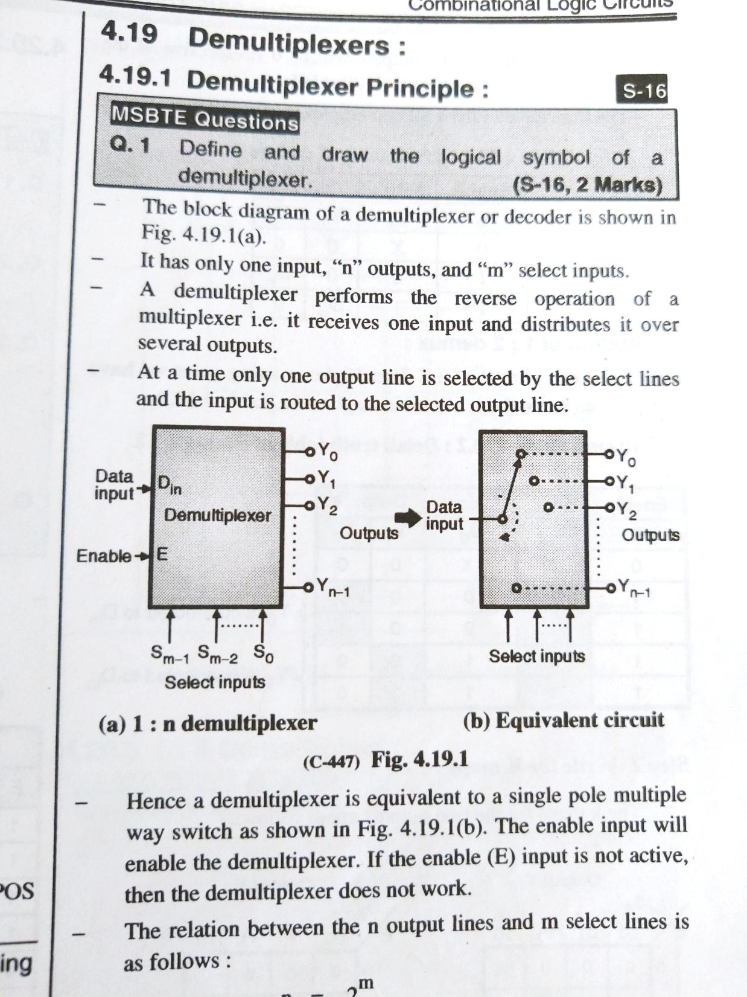
Cont…
A demultiplexer performs the reverse operation of a multiplexer i.e. it receives one input and distributes it over several outputs.
At a time only one output line is selected by the select lines and the input is routed to the selected output line.
Hence a demultiplexer is equivalent to a single pole multiple way switch as shown in Fig.

Slide 44
Types of Demultiplexers
Similar to the multiplexers, the demultiplexers are classified as follows:
1:2 demultiplexer
1:4 demultiplexer
1:8 demultiplexer
1: 16 demultiplexer

Slide 45
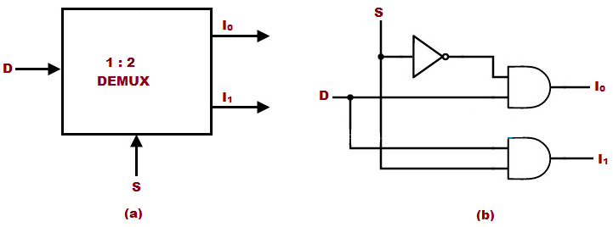
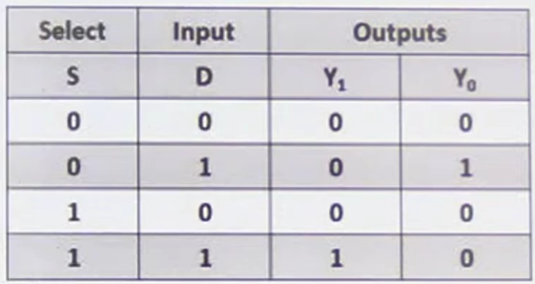
1:2 Demux

Slide 46
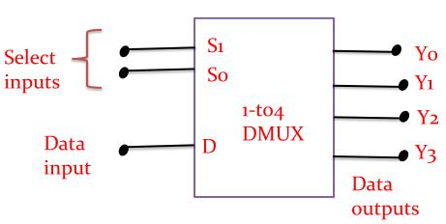
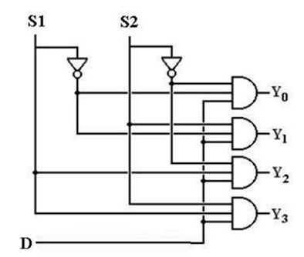
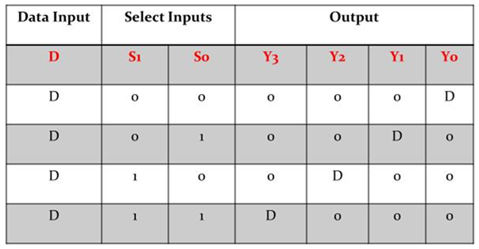
1:4 Demux

Slide 47
1: 8 De-multiplexer
Y₀
Y₁
Data
Input
D_{in}
Y₂
1:8
De-mux
Y₃
Y₄
Y₅
Y₆
E
Y₇
Enable
Input
S₂
S₁
S₀
Select Lines
Block Diagram

Slide 48
1: 8 De-multiplexer
Truth Table
Enable i/p | Select i/p |  |  | Outputs
E | S₂ | S₁ | S₀ | Y₇ | Y₆ | Y₅ | Y₄ | Y₃ | Y₂ | Y₁ | Y₀
0 | X | X | X | 0 | 0 | 0 | 0 | 0 | 0 | 0 | 0
1 | 0 | 0 | 0 | 0 | 0 | 0 | 0 | 0 | 0 | 0 | D_{in}
1 | 0 | 0 | 1 | 0 | 0 | 0 | 0 | 0 | 0 | D_{in} | 0
1 | 0 | 1 | 0 | 0 | 0 | 0 | 0 | 0 | D_{in} | 0 | 0
1 | 0 | 1 | 1 | 0 | 0 | 0 | 0 | D_{in} | 0 | 0 | 0
1 | 1 | 0 | 0 | 0 | 0 | 0 | D_{in} | 0 | 0 | 0 | 0
1 | 1 | 0 | 1 | 0 | 0 | D_{in} | 0 | 0 | 0 | 0 | 0
1 | 1 | 1 | 0 | 0 | D_{in} | 0 | 0 | 0 | 0 | 0 | 0
1 | 1 | 1 | 1 | D_{in} | 0 | 0 | 0 | 0 | 0 | 0

Slide 49
1: 16 De-multiplexer
Y₀
Y₁
Y₂
Y₃
Y₄
Y₅
Y₆
Data
Input
D_{in}
Y₇
1:16
De-mux
Y₈
Y₉
Y₁₀
Y₁₁
Block Diagram
Y₁₂
Y₁₃
Y₁₄
E
Y₁₅
Enable
Input
S₃
S₂
S₁
S₀

Slide 50
De-mux Tree
Similar to multiplexer we can construct the de-multiplexer with more number of lines using de-multiplexer having less number of lines. This is call as “De-mux Tree”.

Slide 51
1:4 De-mux using 1:2 De-mux
Data
Input
Y₀
Y₀
1:2
De-mux
D_{in}
Y₁
Y₁
S₁
E
S₀
Select
Lines
S₀
S₀
Y₀
Y₂
D_{in}
1:2
De-mux
Y₁
Y₃
E

Slide 52
1:16 De-mux using 1:4 De-mux
Y₀
1:4
De-mux
Y₁
D_{in}
Y₂
Y₃
S₁
S₀
S₁
S₀
Y₄
1:4
De-mux
Y₅
D_{in}
Y₆
Data
Input
Y₀
D_{in}
1:4
De-mux
Y₇
Y₁
Y₂
Y₃
S₁
S₀
Y₈
1:4
De-mux
Y₉
D_{in}
Y₁₀
S₃
S₂
S₁
S₀
Y₁₁
S₁
S₀
Y₁₂
D_{in}
1:4
De-mux
Y₁₃
Y₁₄
S₁
S₀
Y₁₅

Slide 53
Applications of Multiplexer
Communication system – Communication system is a set of system that enable communication like transmission system, relay and tributary station, and communication network. The efficiency of communication system can be increased considerably using multiplexer. Multiplexer allow the process of transmitting different type of data such as audio, video at the same time using a single transmission line.
Computer Memory – A Multiplexer is used in computer memory to keep up a vast amount of memory in the computers, and also to decrease the number of copper lines necessary to connect the memory to other parts of the computer.

Slide 54
Applications of De-Multiplexer
Communication System - Communication system use multiplexer to carry multiple data like audio, video and other form of data using a single line for transmission. This process make the transmission easier. The demultiplexer receive the output signals of the multiplexer and converts them back to the original form of the data at the receiving end. The multiplexer and demultiplexer work together to carry out the process of transmission and reception of data in communication system.

Slide 55
74153 Multiplexer IC
Specifications :
TTL ICs i.e. Transistor Transistor Logic ICs.
Total pins = 16 pins.
Dual 4:1 line multiplexer circuit in single package.
Supply voltage = 5V DC ±0.25V.
Operating temperature range = 0°C to +70°C.
High fan-out = 10.
Low impedance < 100Ω
Totem pole outputs.

Slide 56
Decoder
Decoder is a combinational circuit.
It converts n bit binary information at its input into a maximum of 2_{n} output lines.
For example, if n=2 then we can design upto 2:4 decoder

Slide 57
2:4 Decoder
Y₀
A
Inputs
2:4
Decoder
Y₁
Block Diagram
B
Y₂
Y₃
E
Enable
Input
Enable i/p | Data Inputs |  | Outputs
E | A | B | Y₀ | Y₁ | Y₂ | Y₃
0 | X | X | 0 | 0 | 0 | 0
1 | 0 | 0 | 1 | 0 | 0 | 0
1 | 0 | 1 | 0 | 1 | 0 | 0
1 | 1 | 0 | 0 | 0 | 1 | 0
1 | 1 | 1 | 0 | 0 | 0 | 1
Truth Table

Slide 58
De-multiplexer as Decoder
It is possible to operate a de-multiplexer as a decoder.
Let us consider an example of 1:4 de-mux can be used as 2:4 decoder

Slide 59
1:4 De-multiplexer as 2:4 Decoder
V_{cc}
Y₀
D_{in}
Y₀
D_{in}
A
S₁
Data
Input
1:4
De-mux
Y₁
Inputs
1:4
De-mux
Y₁
Y₂
B
S₀
Y₂
Y₃
Y₃
E
Enable
Input
E
Enable
Input
S₁
S₀
Select Lines
1: 4 De-multiplexer
1: 4 De-multiplexer as 2:4 Decoder

Slide 60
Realization of Boolean expression using De-mux
We can implement any Boolean expression using de-multiplexers.
It reduces circuit complexity.
It does not require any simplification

Slide 61
Example 1
Implement following Boolean expression using de-multiplexer
Since there are three variables, therefore a de-multiplexer with three select input is required i.e. 1:8 de-multiplexer is required
The 1:8 de-multiplexer is configured as below to implement given Boolean expression

Slide 62
Example 1 continue…..
+V_{cc}
Y₀
Y₁
Data
Input
Y₂
D_{in}
1:8
De-mux
Y₃
Y
Y₄
Y₅
Y₆
E
S₂
S₁
S₀
Y₇
Enable
Input
A
B
C

Slide 63
Example 2
Implement following Boolean expression using de-multiplexer
Since there are four variables, therefore a de-multiplexer with four select input is required i.e. 1:16 de-multiplexer is required
The 1:16 de-multiplexer is configured as below to implement given Boolean expression

Slide 64
Example 2 continue…..
Y₀
Y₁
Y₂
+V_{cc}
Y₃
Y₄
Y₅
Y₆
Data
Input
1:16
De-mux
Y₇
Y
D_{in}
Y₈
Y₉
Y₁₀
Y₁₁
Y₁₂
Y₁₃
Y₁₄
E
S₃
S₂
Y₁₅
S₁
S₀
Enable
Input
A
B
C
D

Slide 65
Multiplexer ICs
IC Number | Description | Output
IC 74157 | Quad 2:1 Mux | Same as input
IC 74158 | Quad 2:1 Mux | Inverted Output
IC 74153 | Dual 4:1 Mux | Same as input
IC 74352 | Dual 4:1 Mux | Inverted Output
IC 74151 | 8:1 Mux | Inverted Output
IC 74152 | 8:1 Mux | Inverted Output
IC 74150 | 16:1 Mux | Inverted Output

Slide 66
De-multiplexer ICs
IC Number | Description
IC 74138 | 1:8 De-multiplexer
IC 74139 | Dual 1:4 De-multiplexer
IC 74154 | 1:16 De-multiplexer
IC 74155 | Dual 1:4 De-multiplexer

Slide 67
Encoder
Encoder is a combinational circuit which is designed to perform the inverse operation of decoder.
An encoder has ‘n’ number of input lines and ‘m’ number of output lines.
An encoder produces an m bit binary code corresponding to the digital input number.
The encoder accepts an n input digital word and converts it into m bit another digital word

Slide 68
Encoder
‘n’
inputs
‘m’
outputs
.
.
.
Encoder
.
.
.

Slide 69
Types of Encoders
Priority Encoder
Decimal to BCD Encoder
Octal to BCD Encoder
Hexadecimal to Binary Encoder

Slide 70
Priority Encoder
This is a special type of encoder.
Priorities are given to the input lines.
If two or more input lines are “1” at the same time, then the input line with highest priority will be considered.

Slide 71
Priority Encoder 8:3
Highest Priority
D₀
D₁
Y₂
D₂
Priority
Encoder
8:3
‘3’
outputs
‘8’
inputs
D₃
Y₁
D₄
Y₀
D₅
D₆
D₇
Lowest Priority

Slide 72
Priority Encoder 8:3
Truth Table:
Inputs |  |  |  |  |  |  |  | Outputs
D₇ | D₆ | D₅ | D₄ | D₃ | D₂ | D₁ | D₀ | Y₂ | Y₁ | Y₀
0 | 0 | 0 | 0 | 0 | 0 | 0 | 0 | X | X | X
0 | 0 | 0 | 0 | 0 | 0 | 0 | 1 | 0 | 0 | 0
0 | 0 | 0 | 0 | 0 | 0 | 1 | X | 0 | 0 | 1
0 | 0 | 0 | 0 | 0 | 1 | X | X | 0 | 1 | 0
0 | 0 | 0 | 0 | 1 | X | X | X | 0 | 1 | 1
0 | 0 | 0 | 1 | X | X | X | X | 1 | 0 | 0
0 | 0 | 1 | X | X | X | X | X | 1 | 0 | 1
0 | 1 | X | X | X | X | X | X | 1 | 1 | 0
1 | X | X | X | X | X | X | X | 1 | 1 | 1

Slide 73
Decimal to BCD Encoder
D₁
D₂
A
D₃
D₄
Decimal to
BCD
Encoder
B
‘BCD’
outputs
‘9’
inputs
D₅
C
D₆
D₇
D
D₈
D₉

Slide 74
Decimal to BCD Encoder
Truth Table:
Inputs |  |  |  |  |  |  |  |  | Outputs
D₉ | D₈ | D₇ | D₆ | D₅ | D₄ | D₃ | D₂ | D₁ | D | C | B | A
0 | 0 | 0 | 0 | 0 | 0 | 0 | 0 | 0 | 0 | 0 | 0 | 0
0 | 0 | 0 | 0 | 0 | 0 | 0 | 0 | 1 | 0 | 0 | 0 | 1
0 | 0 | 0 | 0 | 0 | 0 | 0 | 1 | X | 0 | 0 | 1 | 0
0 | 0 | 0 | 0 | 0 | 0 | 1 | X | X | 0 | 0 | 1 | 1
0 | 0 | 0 | 0 | 0 | 1 | X | X | X | 0 | 1 | 0 | 0
0 | 0 | 0 | 0 | 1 | X | X | X | X | 0 | 1 | 0 | 1
0 | 0 | 0 | 1 | X | X | X | X | X | 0 | 1 | 1 | 0
0 | 0 | 1 | X | X | X | X | X | X | 0 | 1 | 1 | 1
0 | 1 | X | X | X | X | X | X | X | 1 | 0 | 0 | 0
1 | X | X | X | X | X | X | X | X | 1 | 0 | 0 | 1

Slide 75
Applications of Encoders
Multiplexers: Converts parallel data bus to serial data stream for transmission or vice versa.
Communication Systems: Encodes digital signals for efficient transmission over limited bandwidth channels.
Keyboards and Scanners: Encodes key presses/scan lines into digital format.
Seven Segment Displays: Uses BCD encoders to display decimal numbers.
Barcode Readers: Decodes barcodes scanned as varying reflectance into digital data format.

Slide 76
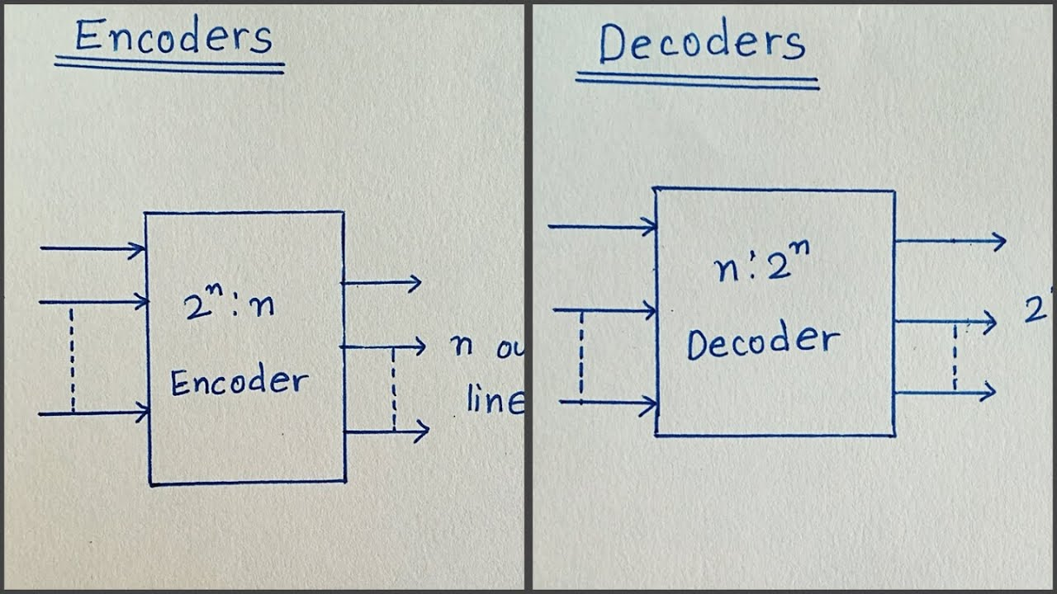

Slide 77
THANK YOU

